Slide 1
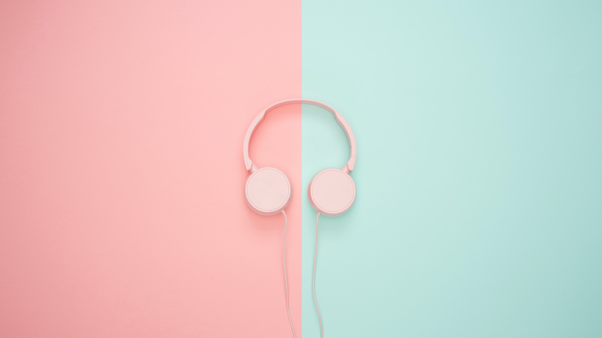


Tune Your Activity
A Study On The Nominal-Nominal Correlation Between The Activities We Do And The Music Choices We Make While Doing Them

Slide 2


AGENDA
Motivation.
Survey Data.
Analysis Questions
4. Data Cleaning.
5.Visualizations.
6.Limitations.

Slide 3


MOTIVATION: Why are we conducting this survey
Music is LIFE: There is no stage or time in life where you don’t find music.
Music tastes differ: Everyone has their own unique preferences.
Are our music preferences dictated by the situation we find ourselves in?

Slide 4

Survey Data
52 Responses
All University Students
We collected information on:
Year of Study
How Often They Listen To Music
Favorite Music Genre
What they are mostly doing while listening to music
Curated a list of common university student activities
What genre of music do you listen to during these activities:
Gym
Cooking
Studying
Walking
Showering/Bathing
Sleeping
Ready for the Day

Slide 5

Analysis Questions
Is there a trend between the favorite genre of music and the time they spend listening to music?
How do students' favorite genres of music compare to the genres they listen to while performing different activities (Gymming in focus)
Which year of study does our survey most accurately represent?
What activity will students most likely be doing when they are listening to music?
Is there a clear favorite genre of music in general?

Slide 6

Data Cleaning
Reduced responses with multiple entries into one by taking the first choice
i.e, Jazz/Pop/Rock → Jazz
Filled empty spaces with N/A
Removed extra words
i.e, Still Bollywood → Bollywood
Capitalized all words
i.e, Jazz → JAZZ

Slide 7

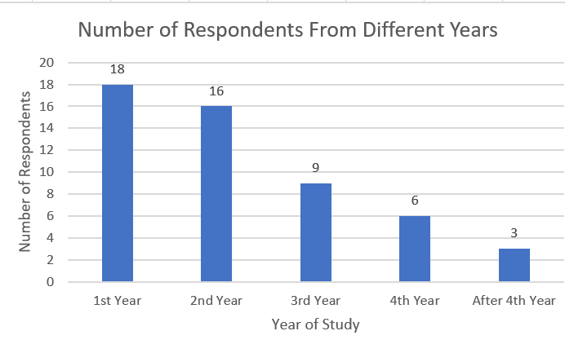
Year of Study
Majority of the participants belong to first and second year
Report shows that analysis will be more consistent with first and second year students compared to other years of study.

Slide 8

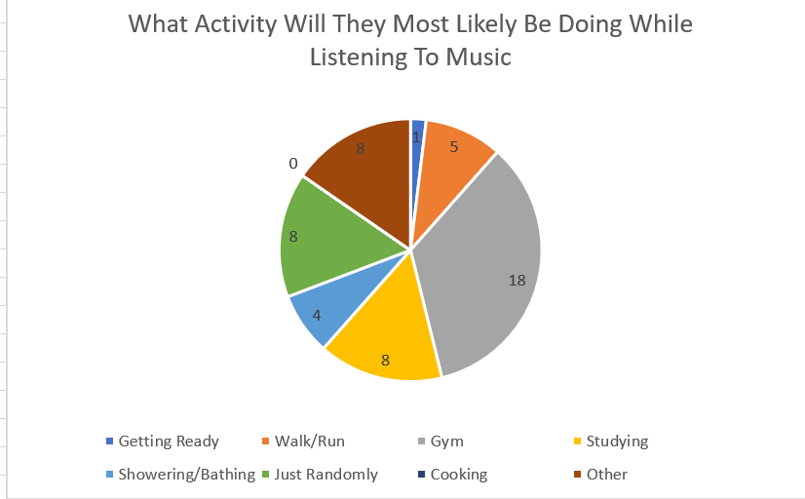
Most Likely Activity
Going to the gym to the gym is the most preferred activity
Only one participant uses music to get ready for the day

Slide 9

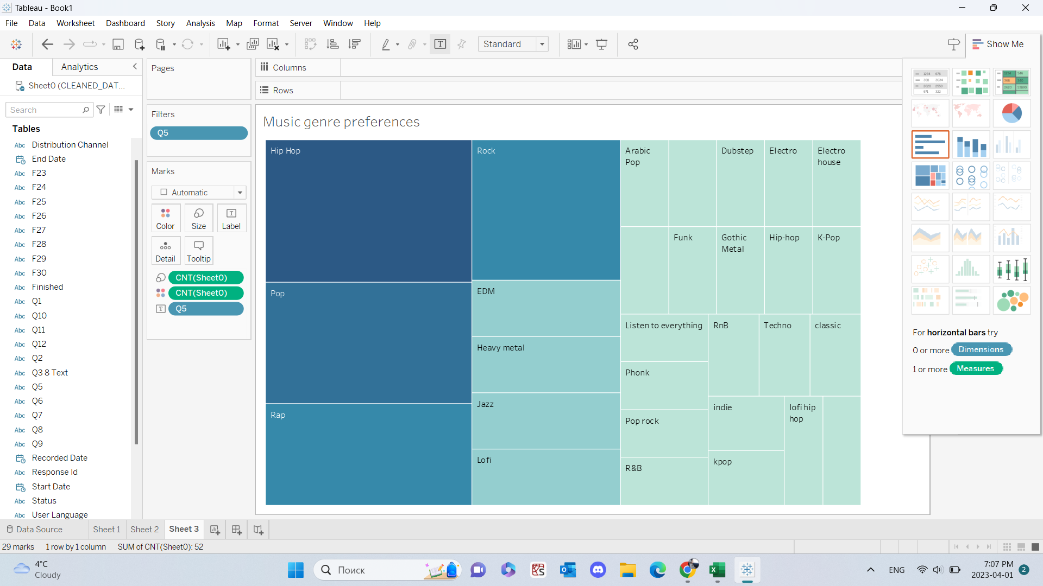
Favourite Genre
Hip-Hop is the most popular
Other popular ones include Pop, Rap, Rock

Slide 10

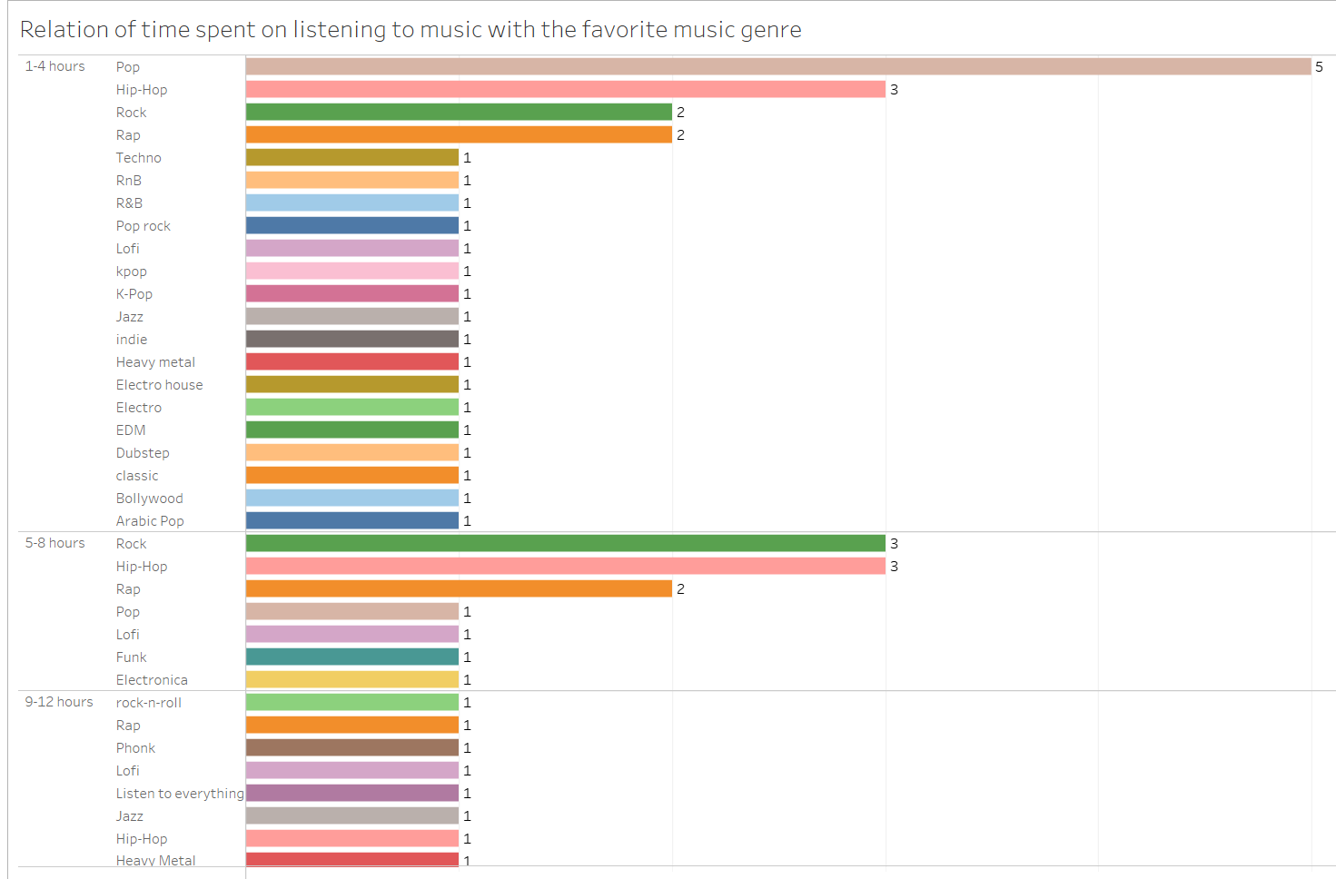
Correlation Between Genre and Time.
Most participants prefer to spend from one to four hours on listening to their favorite music.
Least number of participants prefer to spend from 13-16 hours.
Participants who spend around nine to twelve hours on music have no clear favorite since each of them enjoy different genres.

Slide 11

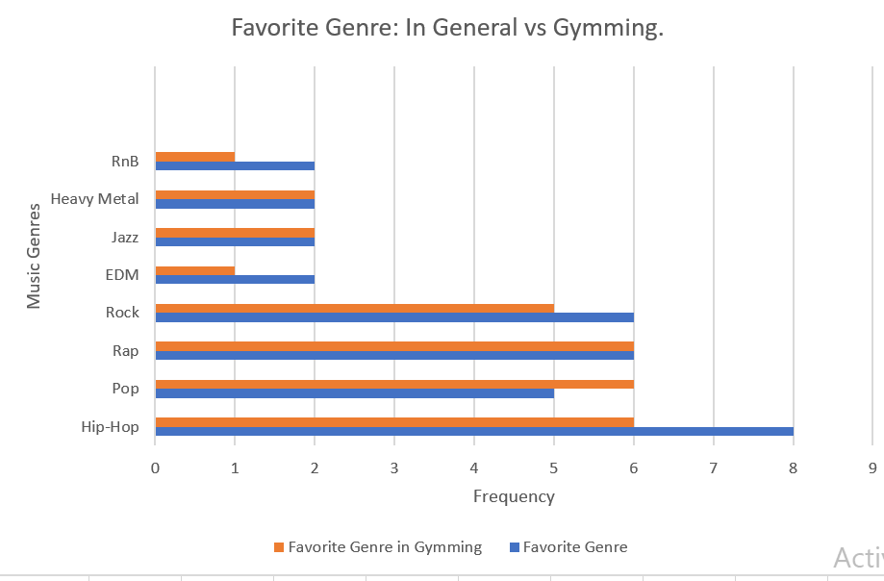
Favorite Genre vs Favorite Genre for Gyming
Gyming is the most popular activity
Correlation Score of 0.92 (Very Strong Positive Relationship)
Similar trends can be observed for other activities
People generally tend to listen to the same genre of music no matter the activity.

Slide 12

Limitations.
Limited Data:
52 people is not a big sample.
Our survey wasn’t open for very long.
Amount of respondents wasn’t enough to highlight variety.
Sampling Bias:
Most responses from friends and classmates who are mostly in 1st and 2nd year.
Years are clusters so we are not totally wrong.

Slide 13

Conclusion.
Predict Trends:
If you choose to do it on a larger scale
You can expect some changes but nothing extreme (like Hip-Hop suddenly becoming the one of the least favorite genres)
Thank You

